Slide 1
In The Dark

Slide 2

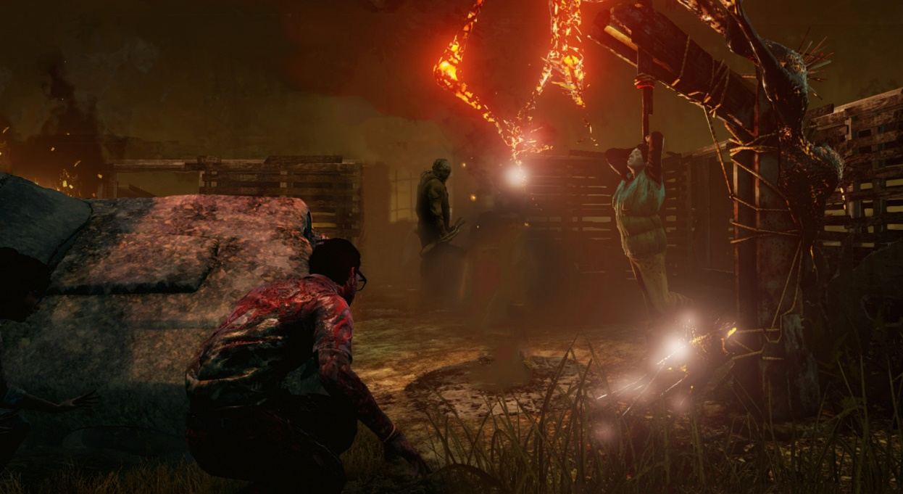
Inspiration – Dead By Daylight
“In The Dark” was inspired by “Dead By Daylight” as the ideas and themes are similar:
4 survivors vs 1 killer
Survivors: Escape!
Killer: Kill them all!
Survivor and Killer bonuses and perks
Engines, Traps, Exits, Barricades

Slide 3
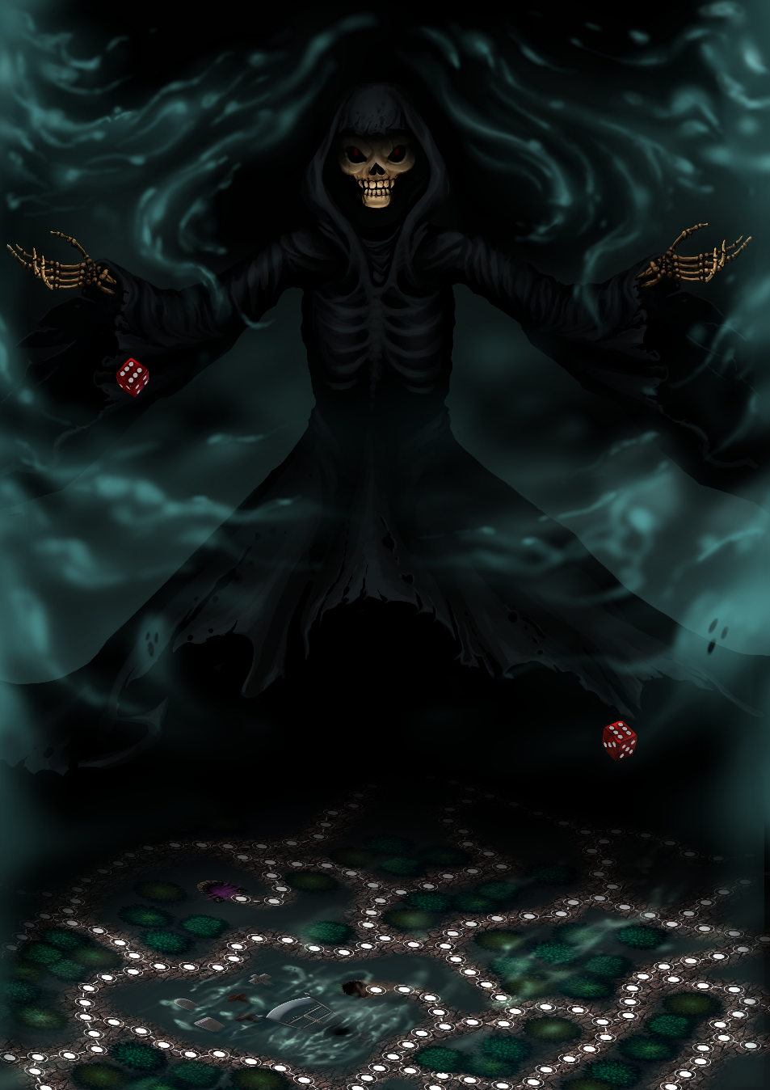
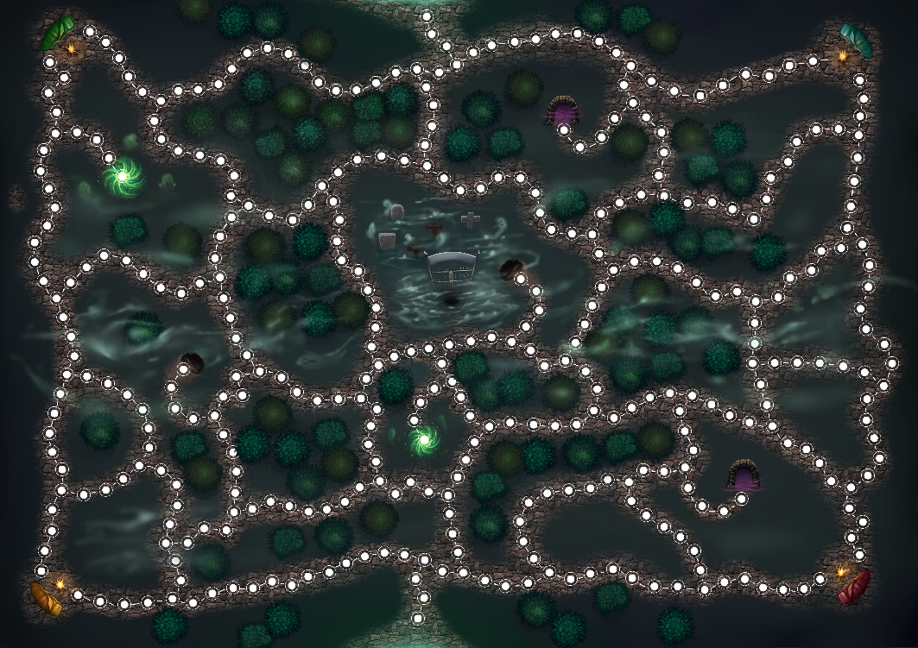
Differences to Dead By Daylight
Turn-Based Board Game
Introduction of tunnels – which transport survivors across the map.
Perks and Bonuses are represented by Cards
Dead By Daylight is Hide & Seek – In The Dark is Tag

Slide 4
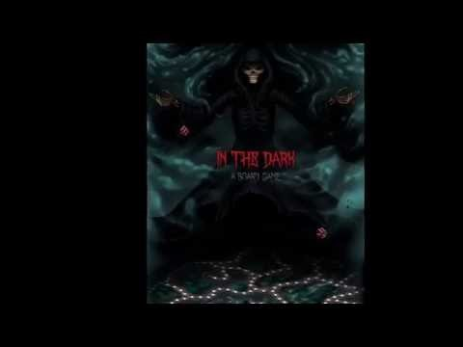
Trailer

Slide 5
Basic Rules and objectives
Survivors
Reaper
Moves with 2 dice.
Receives a bonus card at the start.
Step on an engine and repair it by stacking steps on them.
Repair all generators to open the exits and escape.
Step on chests and receive cards with bonuses.
Step on traps and get stunned for a turn.
Travel through a tunnel to move quickly around the map.
Always move with 2 dice.
Receive up to 2 bonus cards at the start.
Step on a survivor, stop and hit them once.
When hit a survivor can only move with one die until he heals himself.
Hit a survivor twice to kill them.
Kill them all! Let none escape!

Slide 6

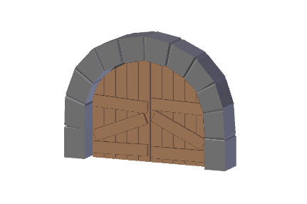
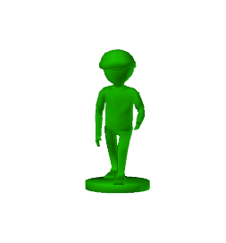
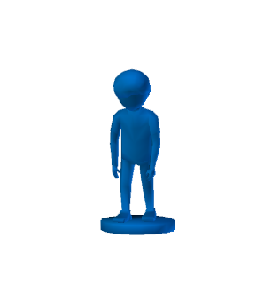

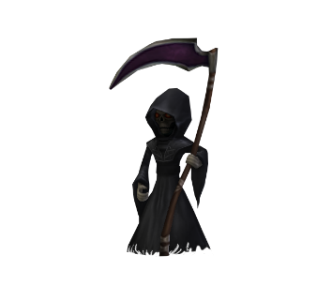
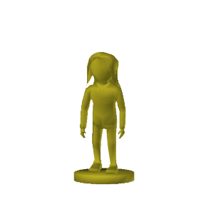
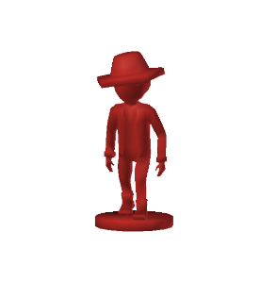
Turn 0

Slide 7
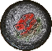

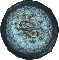
Turn 2

Slide 8
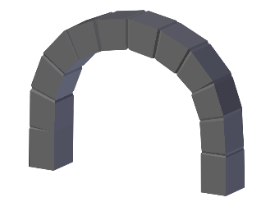
Turn 47

Slide 9
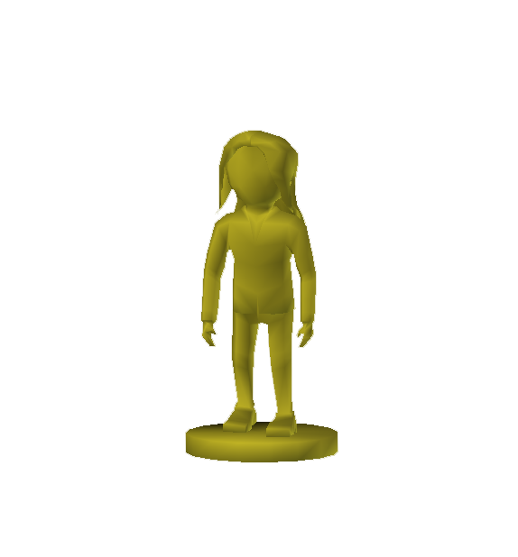
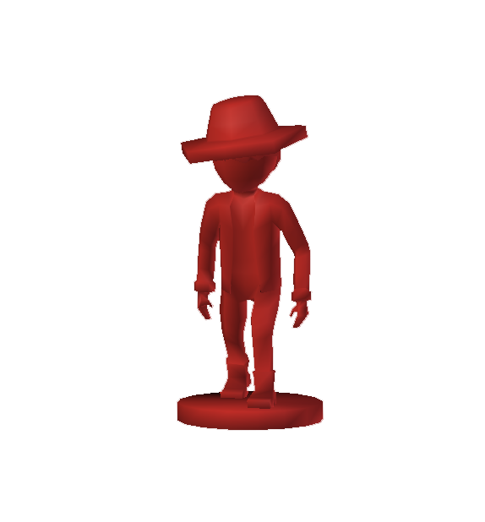

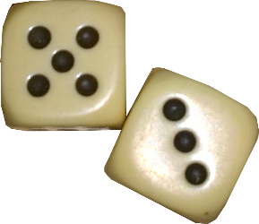
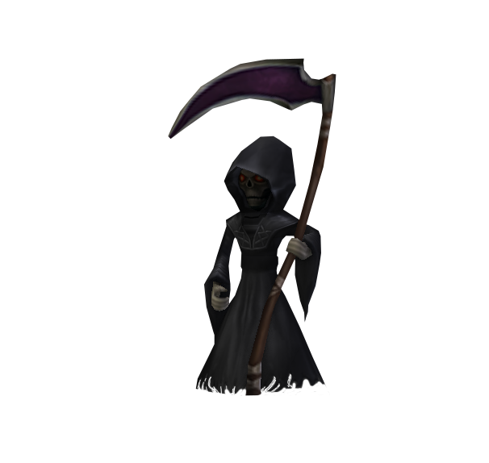
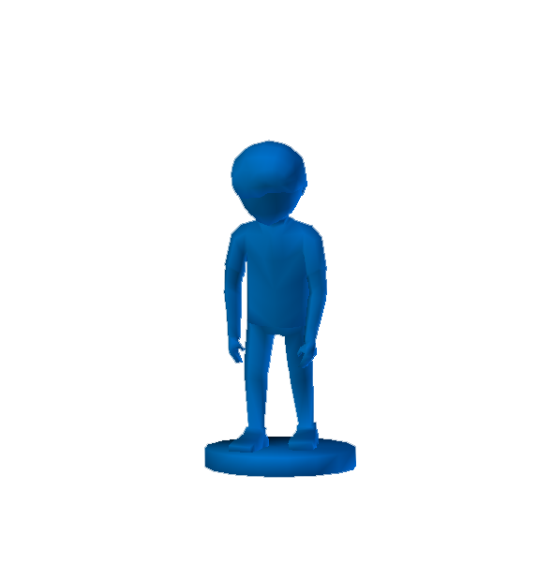
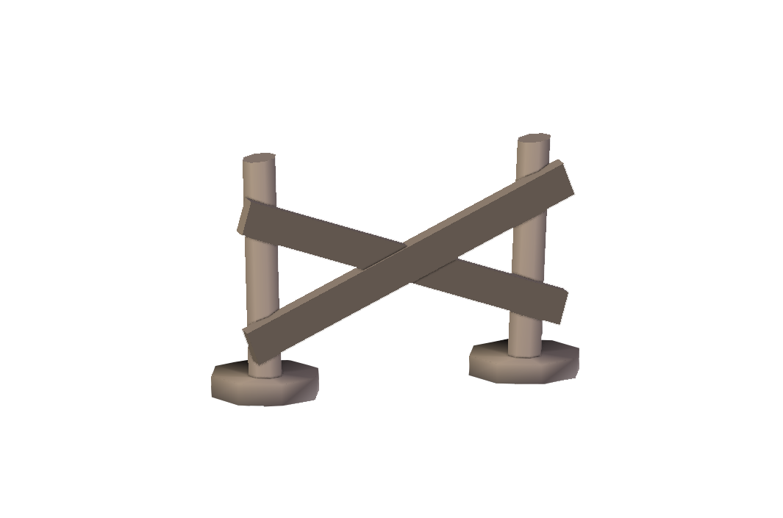
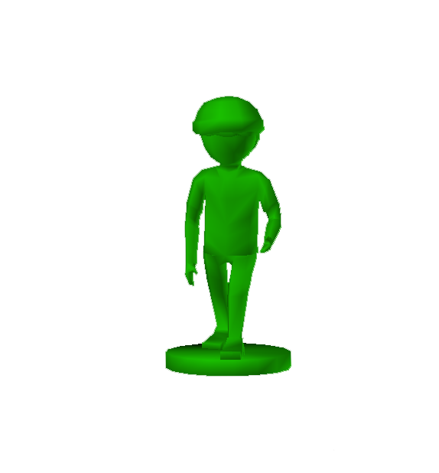
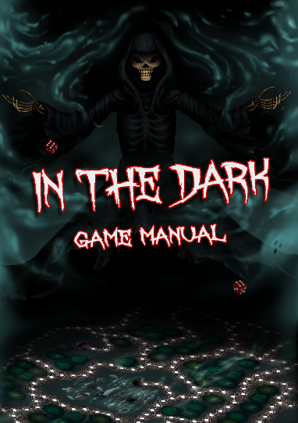
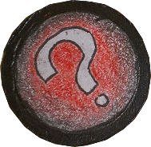
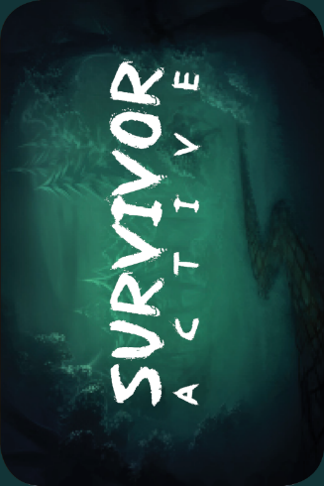
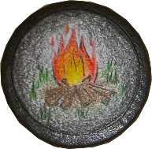
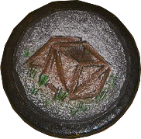
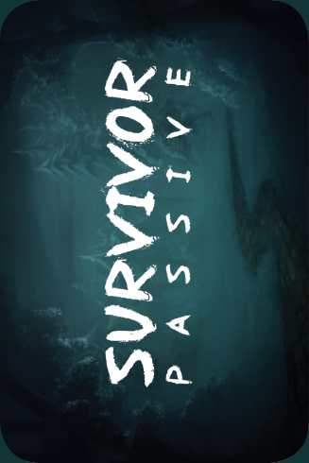
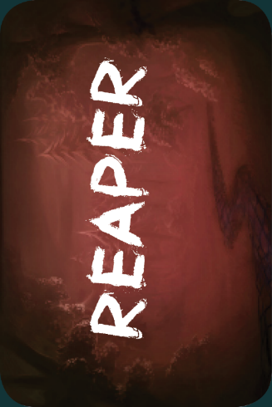
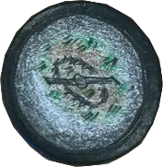
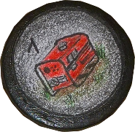
Contents

Slide 10
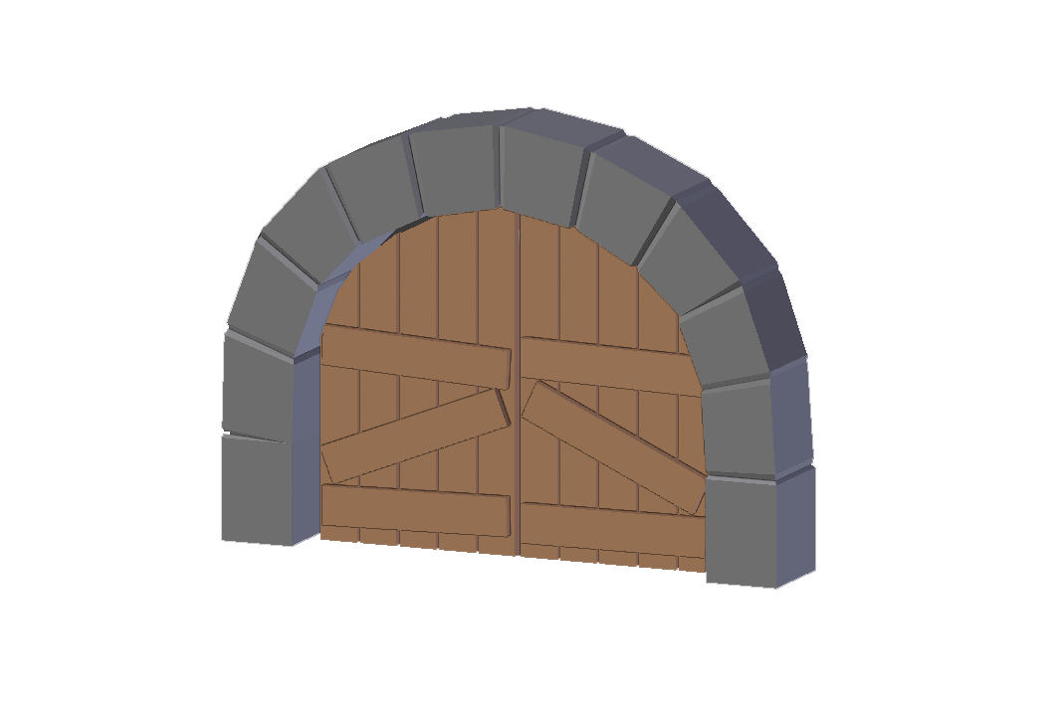
What Tim Did
3D Model Creation
3D Printing
Mood board
Team Planning
Map Layout
Trailer Footage
Provided Pawns, Figurines and Laminated Cards
Playtesting

Slide 11
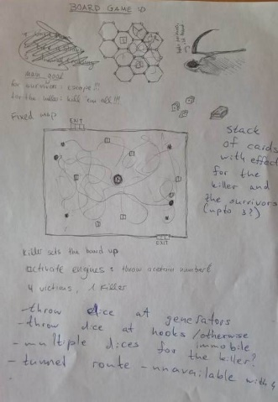
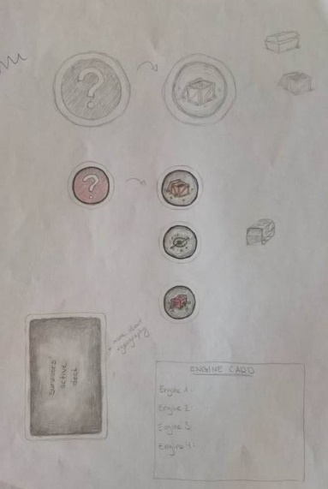
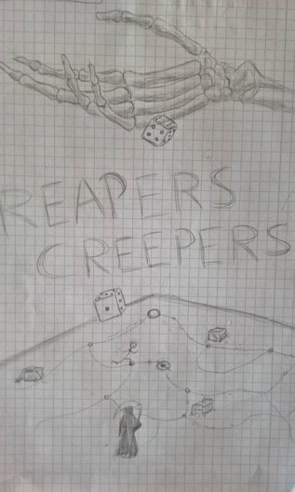
What Mathilde Did
Concept Art
Tokens
Original Idea for “Dead By Daylight”
Team Planning
Provided the substitute pawns
Map Layout
Concept Art For The Poster
Playtesting
The Box

Slide 12

What Slavi Did
Rules
Card Effects
Balancing
Team Planning
Game Documentation
This Presentation
Provided Box and Board
Playtesting
The Box

Slide 13
What Plamen Did
Rulebook
Card Effects
Balancing
Team Planning
The Other Presentation
Game Manual Design
Trailer Footage and Editing
Playtesting
The Box

Slide 14
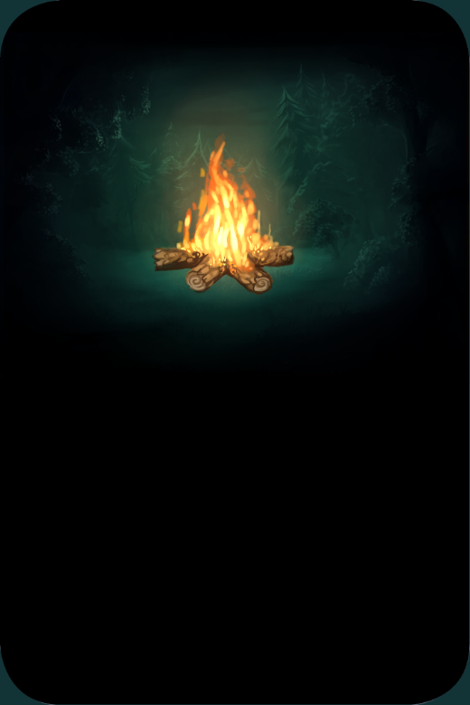
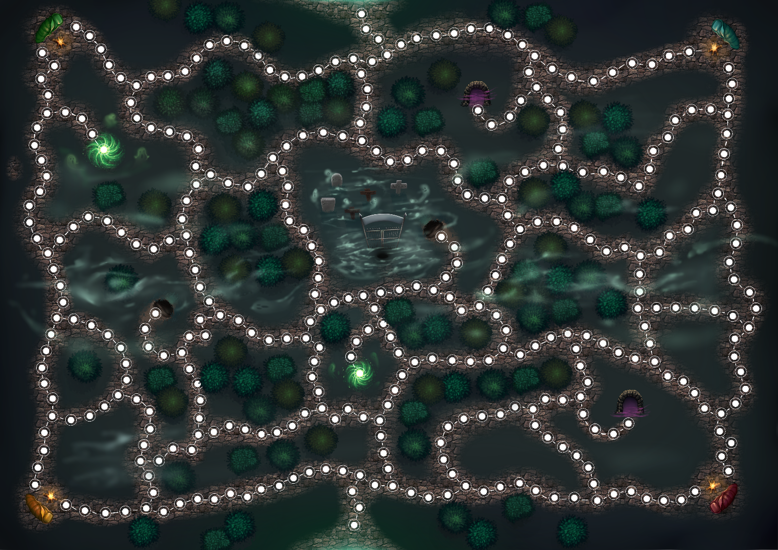

What Jacqueline Did
Map Design
Map Color
Team Planning
Card Design – Back and Front
Card Color – Back and Front
Poster
Playtesting

Slide 15
What we learned
Teamwork
How much resources are needed like: time, money and effort
Communication
That scrumming is very important for deadlines

